Slide 1
Management Practices and Nitrogen Availability for Organic Vegetables
Grace (Guihua) Chen
University of Maryland, Dept. of Entomology
Contact: gchen2@umd.edu, 301-405-3945

Slide 2
Challenges to Synchronize Plant Available N with Crop N Demand
Plant Available N (PAN)
= Mineral Nitrogen (N_{min}) (N-NO₃⁻ & N-NH₄⁺) in the soil
A. Rapid N release fertilizers
B. Slow N release fertilizers
PAN
Crop N demand
Crop N demand
Potential N Deficit
Potential N Loss
PAN

Slide 3
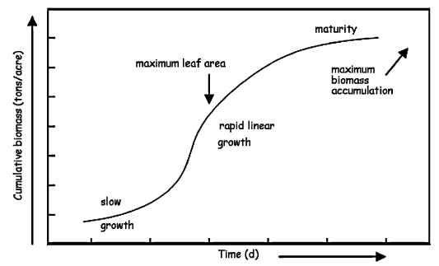
Crop Growth and Total N demand
Cumulative biomass
Maturity
Phase III:
N redistribution (slow or no uptake)
Maximum leaf area
Maximum
Biomass
accumulation
Cumulative biomass (tons/A)
Phase II:
Rapid N uptake
Cumulative N uptake (lb/A)
Maximum N uptake
Rapid linear
growth
Slow growth
Phase I:
Slow N uptake
Time (day)
(Sullivan, et. al., 1999. Oregon State)

Slide 4
Crop Growth and Daily N demand
Cumulative biomass
Maturity
Maximum leaf area
Maximum
Biomass
accumulation
Maximum N uptake rate
Daily N uptake (lb/A)
Rapid linear
growth
Cumulative biomass (tons/A)
Period of rapid N uptake
Slow growth
Time (day)
(Sullivan, et. al., 1999. Oregon State)

Slide 5
Question
How to make soil available N matches with my crop N demand?

Slide 6
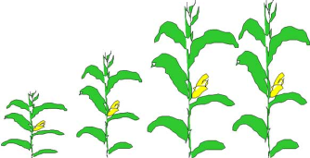
The Nitrogen Cycle
N input
N component
Atmospheric N
N loss
Atmospheric fixation and deposition
Crop harvest
Animal manure
and biosolids
Commercial fertilizers
Plant
residue
Runoff
Erosion
Volatilization
Biological fixation
Plant Uptake
Denitrification
Organic N
Immobilization
Mineralization
Ammonium N (NH₄⁺)
Nitrate N (NO₃⁻)
Nitrification
Leaching

Slide 7
Conditions Controlling Organic N Mineralization and Immobilization
Sources of organic fertilizer:
Carbon to nitrogen (C:N) ratio
Soil moisture and Temperature
Tillage:
Changes in soil moisture, temperature and placement of fertilizers
Sources of organic fertilizer:
Relationships between C:N Ratio and N mineralization

Slide 8
C:N Ratio and N Mineralization Rate
Percent of total N mineralized (Plant Available N) after 4 weeks at Temp= 72⁰F)
Source | %N | C:N ratio | % of total N mineralized
Seabird Guano Pellets (11-10-2.5) | 15 | 3 | 72
Wilbur Ellis 13-0-0 Blood meal | 14 | 4 | 63
Bio-Ggro (8-5-3) fish bone meal | 9 | 4 | 61
Nature's Intent 9-3-4 (feather meal) | 9 | 4 | 63
Wilbur Ellis 10-4.5-0 fish meal | 9 | 4 | 62
Bio-Grow 7-7-2 | 10 | 5 | 58
Concentrate's (soybean meal) | 8 | 5 | 68
X-cel (corn gluten meal) | 10 | 5 | 72
Wilbur-Ellis (3-15-0) bone meal | 9 | 5 | 58
Poultry litter (3.5-2-2) | 3.5 | 10 | 32
Rabbit manure | 3 | 11 | 27
Yard trimming compost | 1.7 | 16 | 5
Alfalfa meal (2.5-0-0) | 2 | 17 | 4
Kelp meal | 1.2 | 27 | 0
(R. Flynn, 2008, New Mexico State University)

Slide 9
C:N Ratio and N Mineralization Rate
Relationship between C:N ratio and PAN after 4 weeks (T = 72⁰F)
(Based on data from R. Flynn, 2008, New Mexico State University)

Slide 10
C:N Ratio and N Mineralization Rate
C:N Ratio of Cover Crops Residues and N Mineralization / Immobilization
Neutral
Mineralization
Immobilization
N mineralization
N Immobilization
Microbes release excess N to soil
Microbes tie up N from soil
C:N Ratio
High N content
Low N content
5:1 10:1 15:1 20:1 30:1 40:1
Clovers
Peas
Radish
Canola
Cereal rye, triticale
Annual ryegrass
(C. White, 2014. Penn State Univ.)
Oats

Slide 11
C:N Ratio and N Mineralization Rate
When to terminate my cover crops?
Vegetative Bud Legume
75% legume
PAN from cover crop (lb/A)
25% legume
Tiller Joint Boot Cereal
3/1 4/1 5/1 6/1
Date of cover crop termination
(Source: D.M. Sullivan and N.D. Andrews, 2012, Oregon State Univ.)

Slide 12
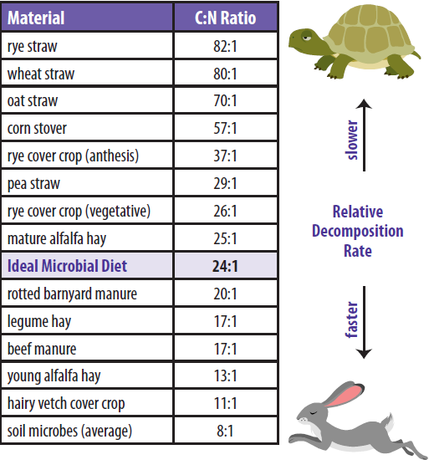
Recommendation:
Grab some soil samples from your field before planting/transplanting to test %N and C:N ratio
(USDA NRCS East National Technology Support Center, Greensboro, NC)

Slide 13
Conditions Controlling Organic N Mineralization and Immobilization
Soil Moisture and Temperature?
Sources of organic fertilizers:
Soil moisture and Temperature
Tillage:
Changes in soil moisture, temperature and placement of fertilizers

Slide 14
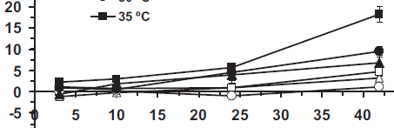
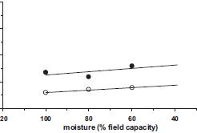
Effects of Temperature on
N Mineralization
Q10
8
6
4
2
0
Soil water content at
A. 60% field capacity
Increasing soil temperature
increases N mineralization rate
B. 80% field capacity
Mineralized N (mg kg⁻¹)
T = 35⁰C
C. 100% field capacity
T = 10⁰C
100 80 60 40
Moisture (% field capacity)
Incubation time (days)
(Guntiñas et al., 2012. Eur. J. Soil Biol.)

Slide 15
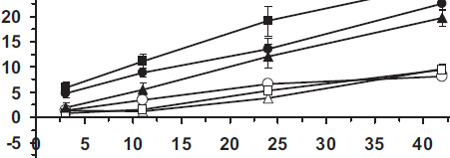
Effects of Soil Moisture on
N Mineralization
A. T = 20⁰C
Water content at
60% FC
80% FC
100% FC
Mineralized N (mg kg⁻¹)
B. T = 25⁰C
No clear clue of mineralized N with changes in moisture
C. T = 30⁰C
Incubation time (days)
(Guntiñas et al., 2012. Eur. J. Soil Biol.)

Slide 16
Conditions Controlling Organic N Mineralization and Immobilization
Tillage Effects?
Sources of organic fertilizers:
Soil moisture and Temperature
Tillage:
Changes in soil moisture, temperature and placement of fertilizers

Slide 17
Tillage Increases N Mineralization Rate
Mineralized N from periodically sampled field soils
(Chen, et al., unpublished data, the project funded by USDA-NIFA ORG program)

Slide 18
Tillage Effects on PAN and Crop N Demand
PAN
PAN matched eggplant N
demand
Potential N loss in CP and
ST in early growing stage?
(Chen, et al., unpublished data, the project funded by USDA-NIFA ORG program)

Slide 19
Summary
Know your crop: the critical period of N uptake and total N demand
Know the C:N ratios of your fertilizers
Make the right decision: Matching crop N uptake pattern with N release pattern from the fertilizers
Low C:N ratio fertilizers:
low rate at planting (or no application if you have legume cover crops)
Moderate to high rate at side-dressing
4. Practice strip-till and No-till:
ST has higher yield potential and same N mineralization rate as CP
Less soil disturbance (from ST and NT) increases your soil organic N pool and productivity
High C:N ratio fertilizers:
High rate at planting
Applying fertilizers of low C:N ratio may be needed at rapid N uptake period

